Slide 1

Drawn controls in .NET MAUI
Javier Suarez
Twitter: @jsuarezruiz

Slide 2

Javier Suárez
Hi!. Mi name is Javier, I work in the Xamarin.Forms and .NET MAUI team at Microsoft. I love participating in technical communities and I am the coordinator of the SevillaDotNet and SVQXDG groups in Seville. You can contact me:
@jsuarezruiz
javiersuarezruiz@hotmail.com
https://javiersuarezruiz.wordpress.com

Slide 3

Do not hesitate to ask!

Slide 4
.NET MAUI Summary
SDK-style projects
Single-headed project
CLI support
.NET 6 BCL
Multi-paradigm
XAML markup & C# UI supported
DESKTOP
MOBILE
.NET MAUI
Windows
iOS
File | New
Multi-platform App UI (.NET)
CLI
dotnet install maui
dotnet new maui
Namespaces
Microsoft.Maui (previously Xamarin.Forms)
Microsoft.Device (previously Xamarin.Essentials)
macOS
Android
Compatibility
Minimal API Changes – All add developer value (perf, dev loop, etc.)
Migration support for Xamarin & Xamarin.Forms
Existing Xamarin.Forms app support for one-year window after release of .NET MAUI

Slide 5
Goals of .NET MAUI
Quality
12 months of Xamarin quality releases.
Reorganized Project structure.
Standardized class naming and structure.
Performance
Faster cold start.
Reduced view nesting.
Design
Easy control extensibility
Quick cross-platform templating
Platforms
Android
iOS
macOS
Windows
Feature parity

Slide 6
Experimental Drawn Controls

Slide 7
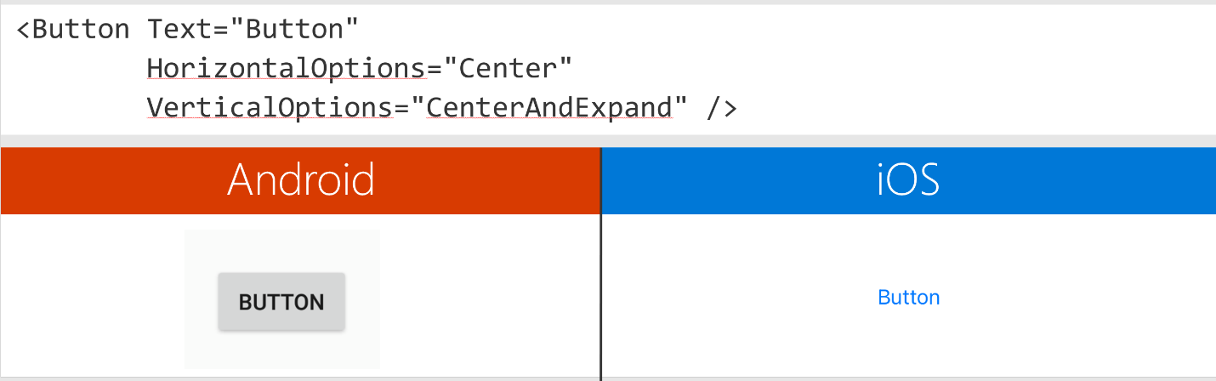
Feedback received
Consistent look and behavior.
Easy way to extend and customize.
The Visual Material implementation is consistent, but rigid in its prescriptive design which doesn’t match some customer designs.

Slide 8
Microsoft.Maui.Graphics
Microsoft.Maui.Graphics is a cross-platform graphics library for iOS, Android, Windows, macOS, Tizen and Linux completely in C#. With this library you can use a common API to target multiple abstractions allowing you to share your drawing code between platforms, or mix and match graphics implentations within a singular application.

Slide 9
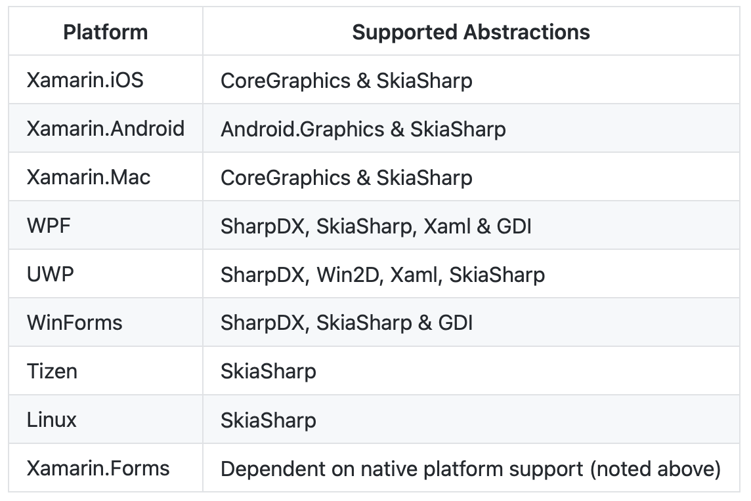
Microsoft.Maui.Graphics: Supported platforms

Slide 10
DEMO: Microsoft.Maui.Graphics

Slide 11
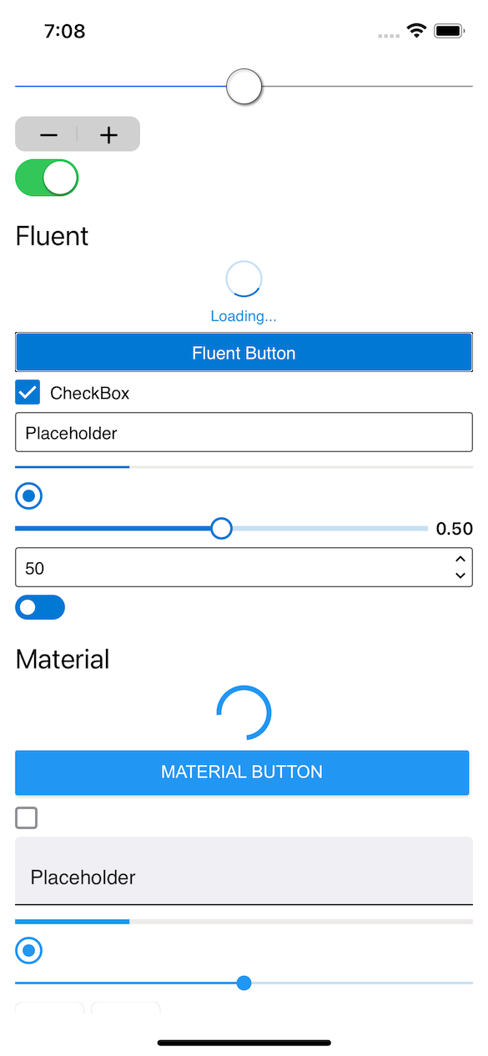
Microsoft.Maui.Graphics.Controls
Microsoft.Maui.Graphics.Controls (GraphicsControls) is a library that offers the controls available in Xamarin.Forms Visual allowing to choose between Cupertino, Fluent and Material but, instead of creating native controls, are drawn controls.
This project is a .NET experiment related to .NET MAUI with different tests to validate the interest and feasibility of drawn controls but is not covered by Microsoft support (yet).

Slide 12
Microsoft.Maui.Graphics.Controls
Available controls:
ActivityIndicator (Cupertino, Fluent, Material)
Button (Cupertino, Fluent, Material)
CheckBox (Cupertino, Fluent, Material)
DatePicker (Cupertino, Fluent, Material)
Editor (Cupertino, Fluent, Material)
Entry (Cupertino, Fluent, Material)
ProgressBar (Cupertino, Fluent, Material)
RadioButton (Cupertino, Fluent, Material)
Slider (Cupertino, Fluent, Material)
Stepper (Cupertino, Fluent, Material)
Switch (Cupertino, Fluent, Material)
TimePicker (Cupertino, Fluent, Material)

Slide 13

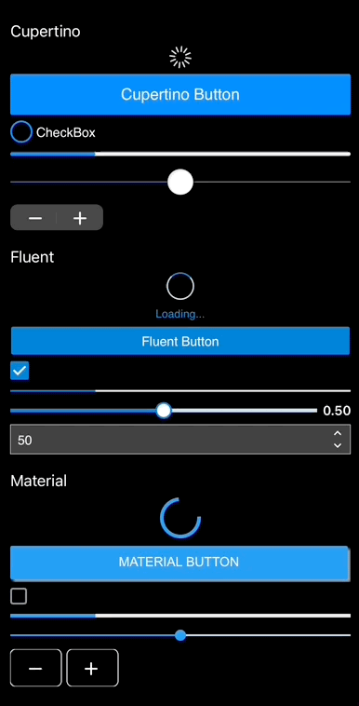
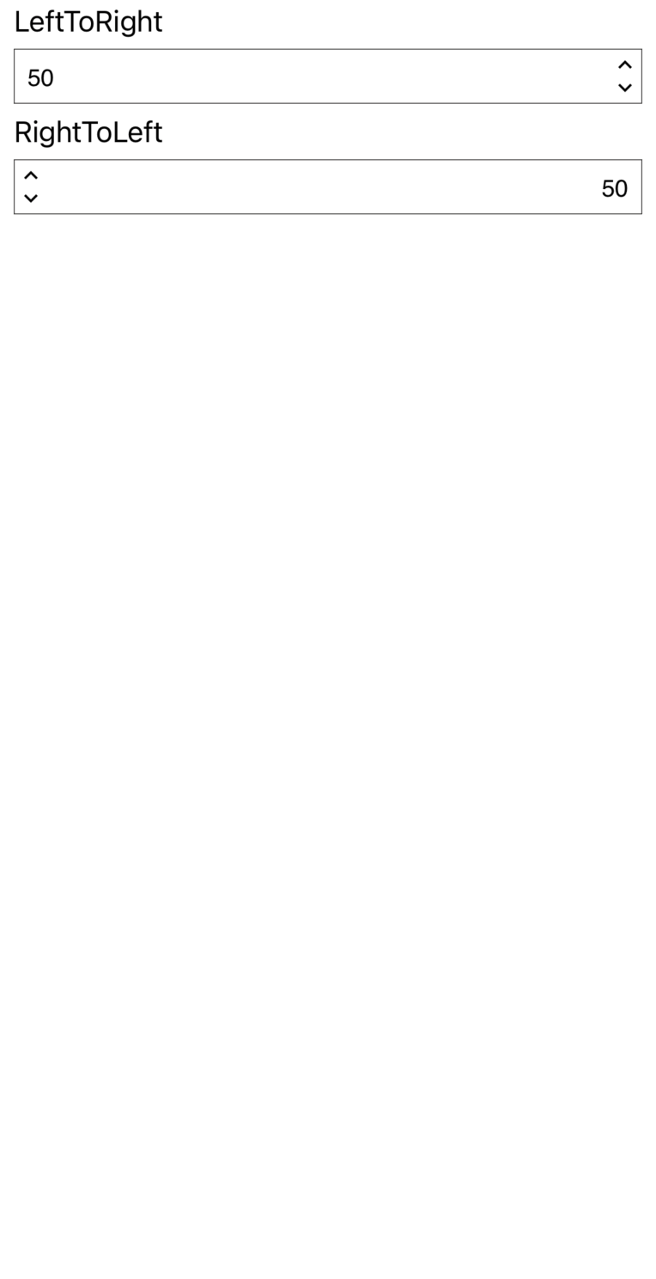
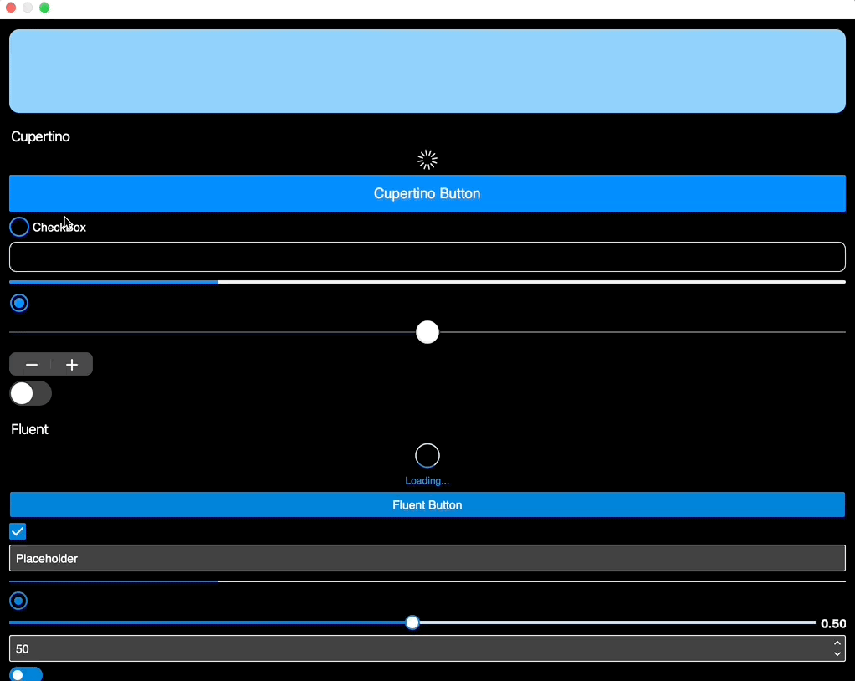
Microsoft.Maui.Graphics.Controls
Features:
Pixel perfect drawn and same behavior in all the platforms.
RTL support.
Accesibility support.
Themes support.
Phone and Desktop support.

Slide 14
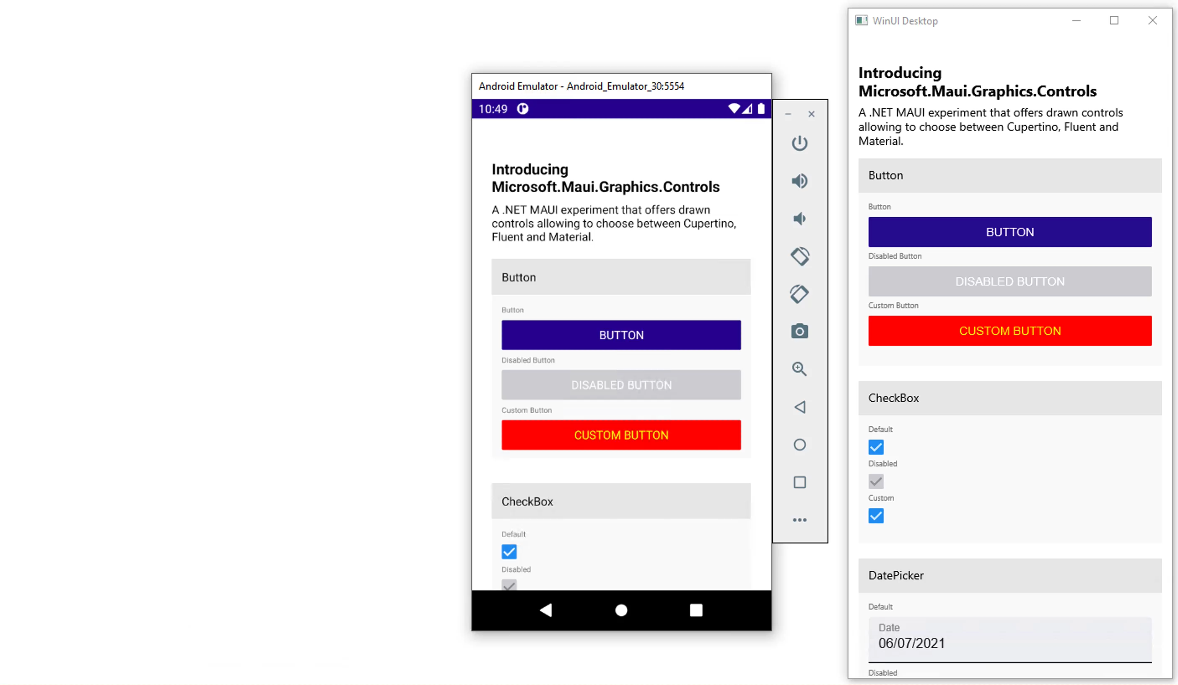
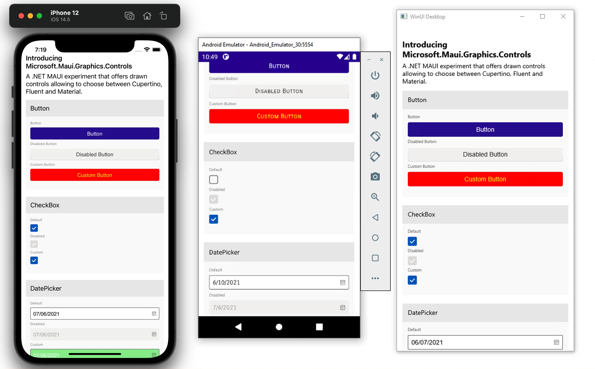
Microsoft.Maui.Graphics.Controls
Features:
Cupertino, Fluent and Material design.
Material
Fluent

Slide 15
DEMO: Microsoft.Maui.Graphics.Controls

Slide 16
Customize Drawn Controls

Slide 17
Extend graphics controls
The easiest way to extend an existing drawn control is to simply override its Draw method to draw any extra content.
public class CustomSliderHandler : SliderHandler
{
protected override ISliderDrawable CreateDrawable() => new MaterialSliderDrawable();
public override void Draw(ICanvas canvas, RectangleF dirtyRect)
{
base.Draw(canvas, dirtyRect);
// Your own content
}
}

Slide 18
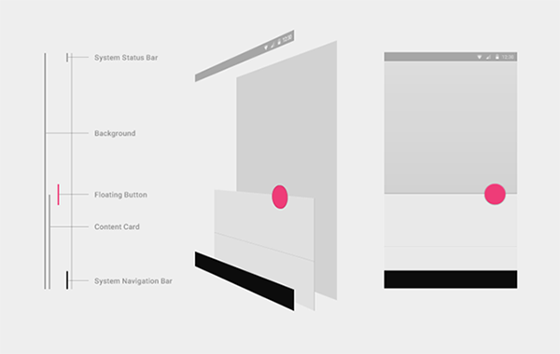
Extend graphics controls
All drawn controls are created by layers. It is possible to access each layer, in addition to customizing a specific layer or adding/removing layers.
As in .NET MAUI, drawn controls use Handlers and a DrawMapper with information about each layer.

Slide 19
Extend graphics controls
Customize how to draw a specific layer.
DrawMapper[nameof(ISliderDrawable.DrawThumb)] = (canvas, rect, drawable, slider) =>
{
}

Slide 20
Extend graphics controls
All drawn control Handlers support a Drawable. A Drawable defines the set of elements to draw on the screen by the control. We can quickly switch between Cupertino, Fluent and Material where what we are really doing is, change the Drawable to use.
We can set a custom Drawable in case we want to change how each part of a specific control is drawn.
public class CustomSliderHandler : SliderHandler
{
protected override ISliderDrawable CreateDrawable() => new CustomDrawable();
}
public class CustomDrawable : ViewDrawable<ISlider>, ISliderDrawable
{
public void DrawBackground(ICanvas canvas, RectangleF dirtyRect, ISlider slider) { }
public void DrawText(ICanvas canvas, RectangleF dirtyRect, ISlider slider) { }
public void DrawThumb(ICanvas canvas, RectangleF dirtyRect, ISlider slider) { }
public void DrawTrackProgress(ICanvas canvas, RectangleF dirtyRect, ISlider slider) { }
}

Slide 21
DEMO: Customize existing Microsoft.Maui.Graphics.Controls

Slide 22
Create custom graphics controls
To create a custom control, just use the GraphicsView control. This control creates a Canvas and allows you to draw what you want using the Draw method.
GraphicsView also has touch events, more complex options to organize the drawing in layers, etc
public class Persona : GraphicsView
{
public override void Draw(ICanvas canvas, RectangleF dirtyRect)
{
base.Draw(canvas, dirtyRect);
}
}

Slide 23
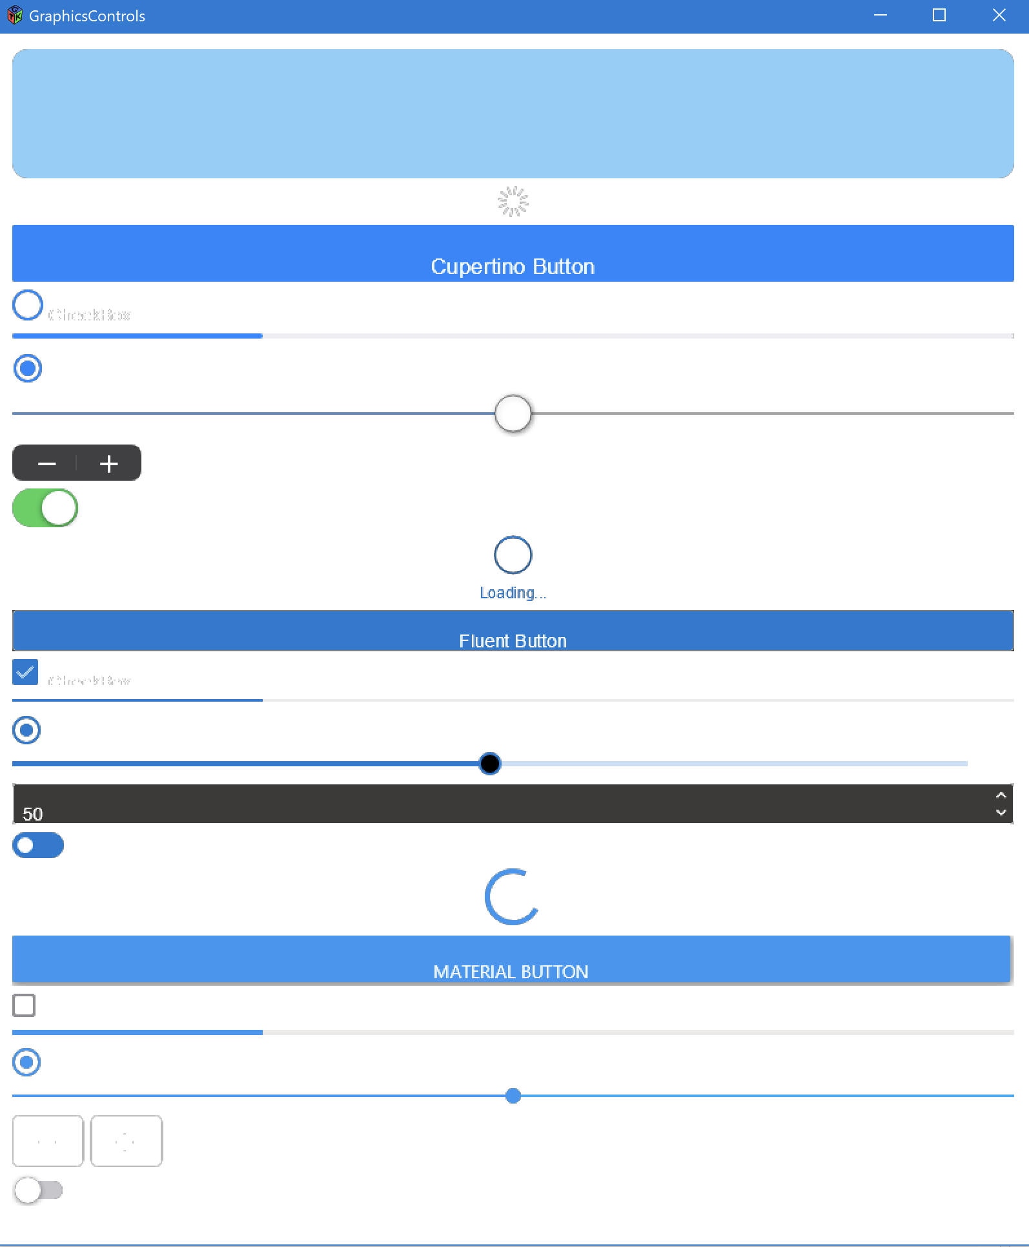

Experimental stuff
Reaching new platforms is easier!. While using native stuff require a Handler to map each .NET MAUI control to a native control, with drawn controls "only" require to map the GraphicsView, the canvas where draw along with being able to access touch events, etc.
https://github.com/jsuarezruiz/maui-linux

Slide 24
Microsoft.Maui.Graphics.Controls
Pros
Drawn controls with high performance and gicing a consistent look and behavior.
Possibility to customize or extend anything.
When creating new controls, you only must know the drawing APIs, you do not need native knowledge of each platform or write code for each platform. Same code, same appearance and behavior on all platforms.
Cons
Is not a native control, it replicates the appearance of the native control and has accessibility RTL options etc but you cannot extend it with native development knowledge.
If something changes in the appearance of the control, effort must be made to update the drawing code.

Slide 25
Next steps!
Add RenderMode property:
Complete pending controls properties.
Complete pending details related with Themes.
More accesibility options like high contrast colors.
Add more ways to extend or customize every control (a XAML option).
RenderMode=“Native|Skia”

Slide 26

GraphicsControls. Feedback.
https://github.com/dotnet/GraphicsControls/issues/1

Slide 27
Summary
Microsoft.Maui.Graphics.Controls is an experimental library that offers the controls available in Xamarin.Forms Visual allowing to choose between Cupertino, Fluent and Material but, instead of creating native controls, are drawn controls.
Already implemented Visual controls with theme, RTL and accesibility support.
Could be part of .NET MAUI in the future, at the moment, we collect feedback.

Slide 28
Releases
We are considering whether to include GraphicsControls in .NET 7 as part of the .NET MAUI. At the moment, it is an experimental library in which we explore ideas and above all we get feedback from the community, developers, etc. to know if it is an interesting way to create better apps.
Prior to that, NuGet Preview packages will be released to be able to test alongside the .NET MAUI Previews.
It would be the alternative to Xamarin.Forms Visual.

Slide 29

Questions?

Slide 30

Thanks!
https://github.com/jsuarezruiz/XamExpertDay2021

